Slide 1

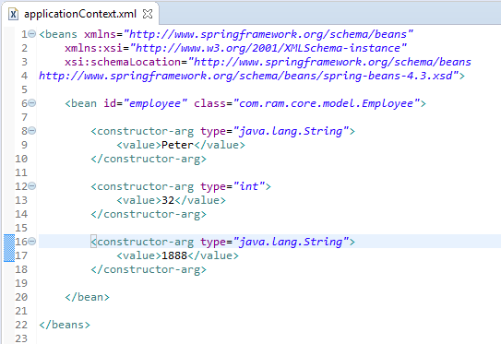
Constructor injection type ambiguities in Spring
Employee class contains two constructor methods, both accept 3 arguments with different data type.
In Spring framework, when your class contains multiple constructors with same number of arguments, it will always cause the constructor injection argument type ambiguities issue.
if Spring can’t resolve which constructor to use, it will prompt following error message
constructor arguments specified but no matching constructor found in bean 'CustomerBean' (hint: specify index and/or type arguments for simple parameters to avoid type ambiguities)
It’s always a good practice to explicitly declared the data type for each constructor argument, to avoid constructor injection type ambiguities issue.

Slide 2


Constructor injection type ambiguities in Spring

